Slide 1
Smart Energy Management
SMART ELECTRICITY MONITOR

Slide 2
Contents
01
02
03
Solution Overview
Key Benefits
Introduction
04
05
06
Features
Visualization
Tech Stack

Slide 3
INTRODUCTION
The Smart Electricity Monitor is a project that aims to provide an efficient solution for monitoring and analysing the electricity consumption of a home or a building. The project uses IOT-Enabled micro-controllers to collect data on the electrical parameters such as voltage, current, and power consumption.
The data is then processed and analysed using various data analytics techniques to provide insights to the user, helping them optimize their energy usage and reduce their electricity bills.
The system also provides a mobile application interface that allows the user to view the live readings of the meter, view historic data and analysis, remotely control the power supply to their devices and receive alerts and notifications in case of voltage fluctuations or abnormal electricity usage.
The project utilizes hardware components such as sensors, microcontrollers, and relay switches to collect, process, and control the electricity consumption.
The Smart Electricity Monitor project is an innovative and practical solution for energy management, contributing towards a sustainable future.

Slide 4
PROBLEM STATEMENT
In India, although digital meters are set up in every domestic and commercial building, the data collection process is still manual in most of India.
Manual Data collection has many drawbacks, If nobody is in the building when the data collection staff visits, the current month’s Electricity Bill is coupled with the previous month. Which might result in the property owner paying a huge amount (since the Average cost per unit increases with the total units consumed).
Also in critical cases similar to the Covid-19 pandemic, manual data collection is not possible.
A typical Indian citizen is also less educated about the methods to avoid wastage of electricity and hence using a smart system can analyse the user’s electricity consumption and help him make informed decisions.
It is estimated that by automating the manual data collection process and by employing smart energy saving techniques, a normal Indian household can save around 15-20% of their total monthly Electricity Cost.

Slide 5
SOLUTION OVERVIEW
The solution we are proposing makes use of a IOT-enabled smart meter that collects the current, voltage and power consumption of a building and an analysis of the user’s daily energy consumption.
The smart meter is a affordable alternative to existing digital meter. It costs around INR 1500 for installation but ROI can be achieved within months of installation in terms of electricity cost-savings.
Apart from providing analysis of the energy consumption, the smart meter also provides alerts to the user in case of power fluctuation or overconsumption by a certain appliance and also remote control of individual appliances.
The data collected from these meter can also be used by the government to update their policies and billings for the EB sectors and hence, helping them make more Eco-friendly decisions.
The Mobile App provides insights to the user which he can then reflect and make more cost-friendly decisions.

Slide 6
Key benefits
15%
20%
15%
Total Energy Consumption Reduction in Domestic Household
Total Electricity Consumption Reduction in Commercial Workplaces.
Total Cost Reduced for a typical Indian Household

Slide 7
Features
Monitoring & Visualization of Energy Consumption
Setting Energy Conservation Goals
Automatically turns off current when overload occurs
Alerts and Notifications
Calculate and reduce your Electricity Bills

Slide 8
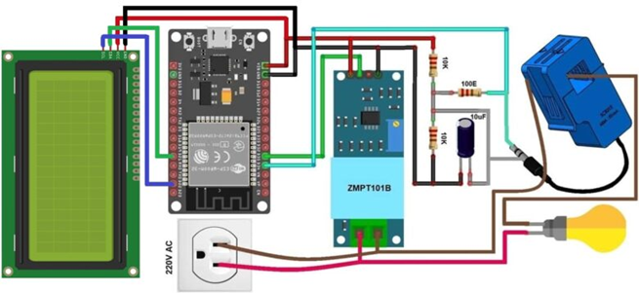
Control unit design using Fritzig Software
The architecture diagram showcases the interconnected components of the smart energy meter system. The smart energy meter acts as the central hub, communicating wirelessly with the mobile application. The relay module, voltage sensor, and current sensor are all connected to the main board of the energy meter, allowing for efficient control and monitoring of electrical devices.

Slide 9
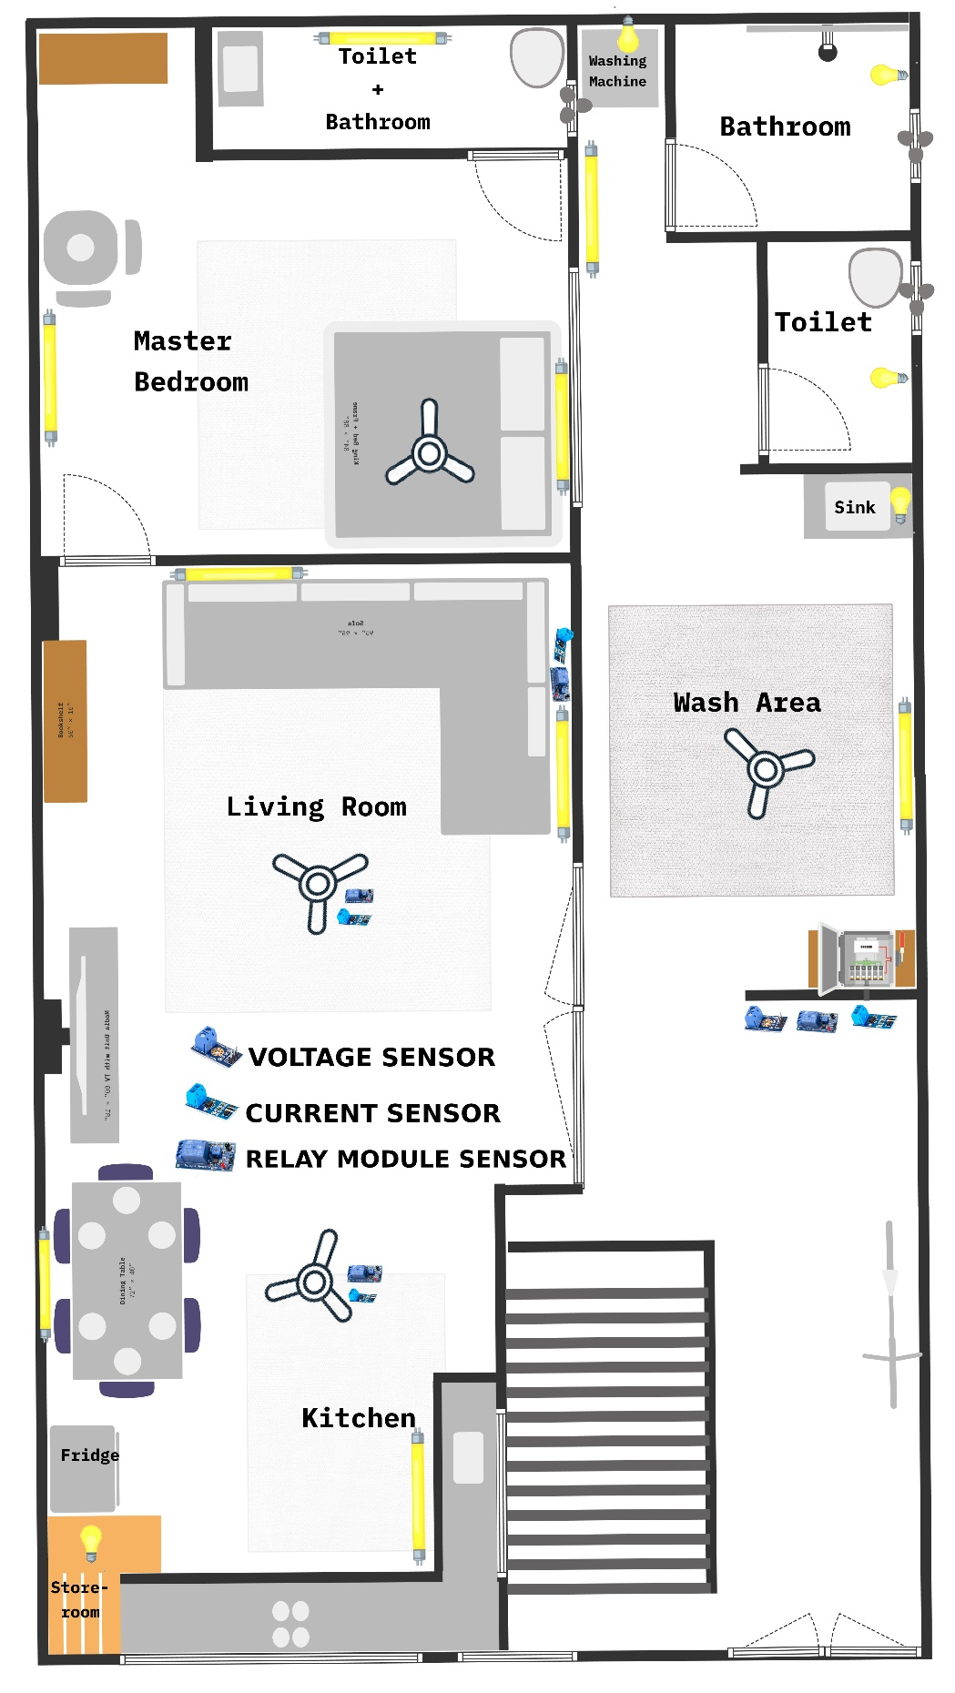
Sensor placement model in household electronic devices Our smart energy meter project encompasses the following key components: Relay Module: A set of relay modules is utilized to facilitate remote control of electrical devices. By integrating this module, users can conveniently switch devices on/off from anywhere using their smartphones. Voltage Sensor: This sensor is employed to measure the voltage levels of connected devices accurately. It provides real-time data on the power consumption of each device, enabling users to make informed decisions. Current Sensor: The current sensor plays a crucial role in monitoring the current consumption of individual devices. By tracking the energy usage, users can identify potential energy inefficiencies and optimize their usage accordingly.

Slide 10
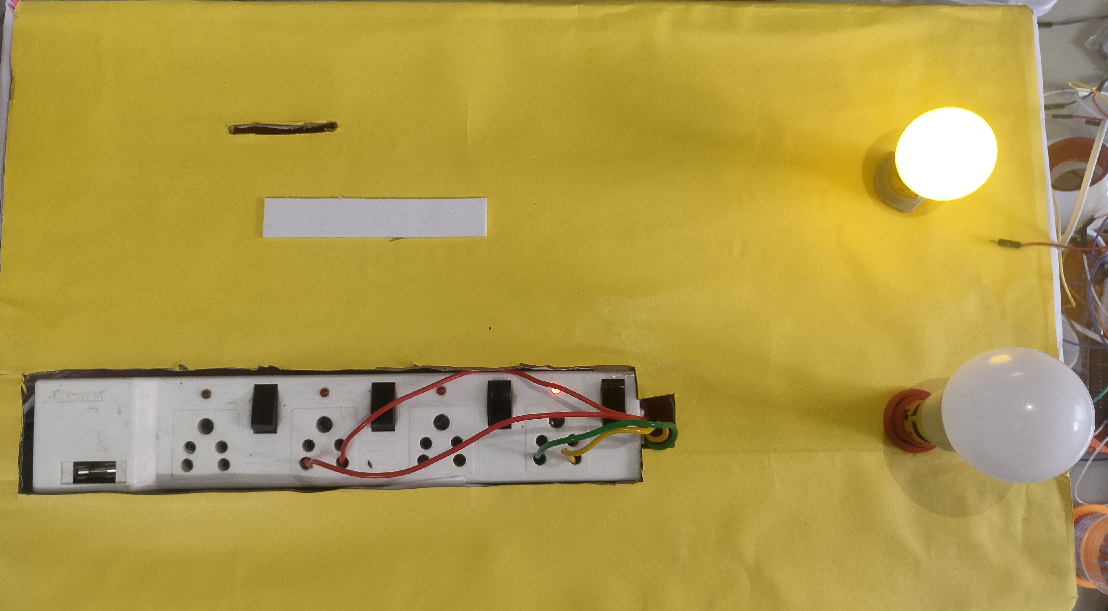
Smart Energy Meter
Device 2
2nd Sample home appliance
Switch board, similar to an home appliances
Device 1
1st Sample home appliance

Slide 11
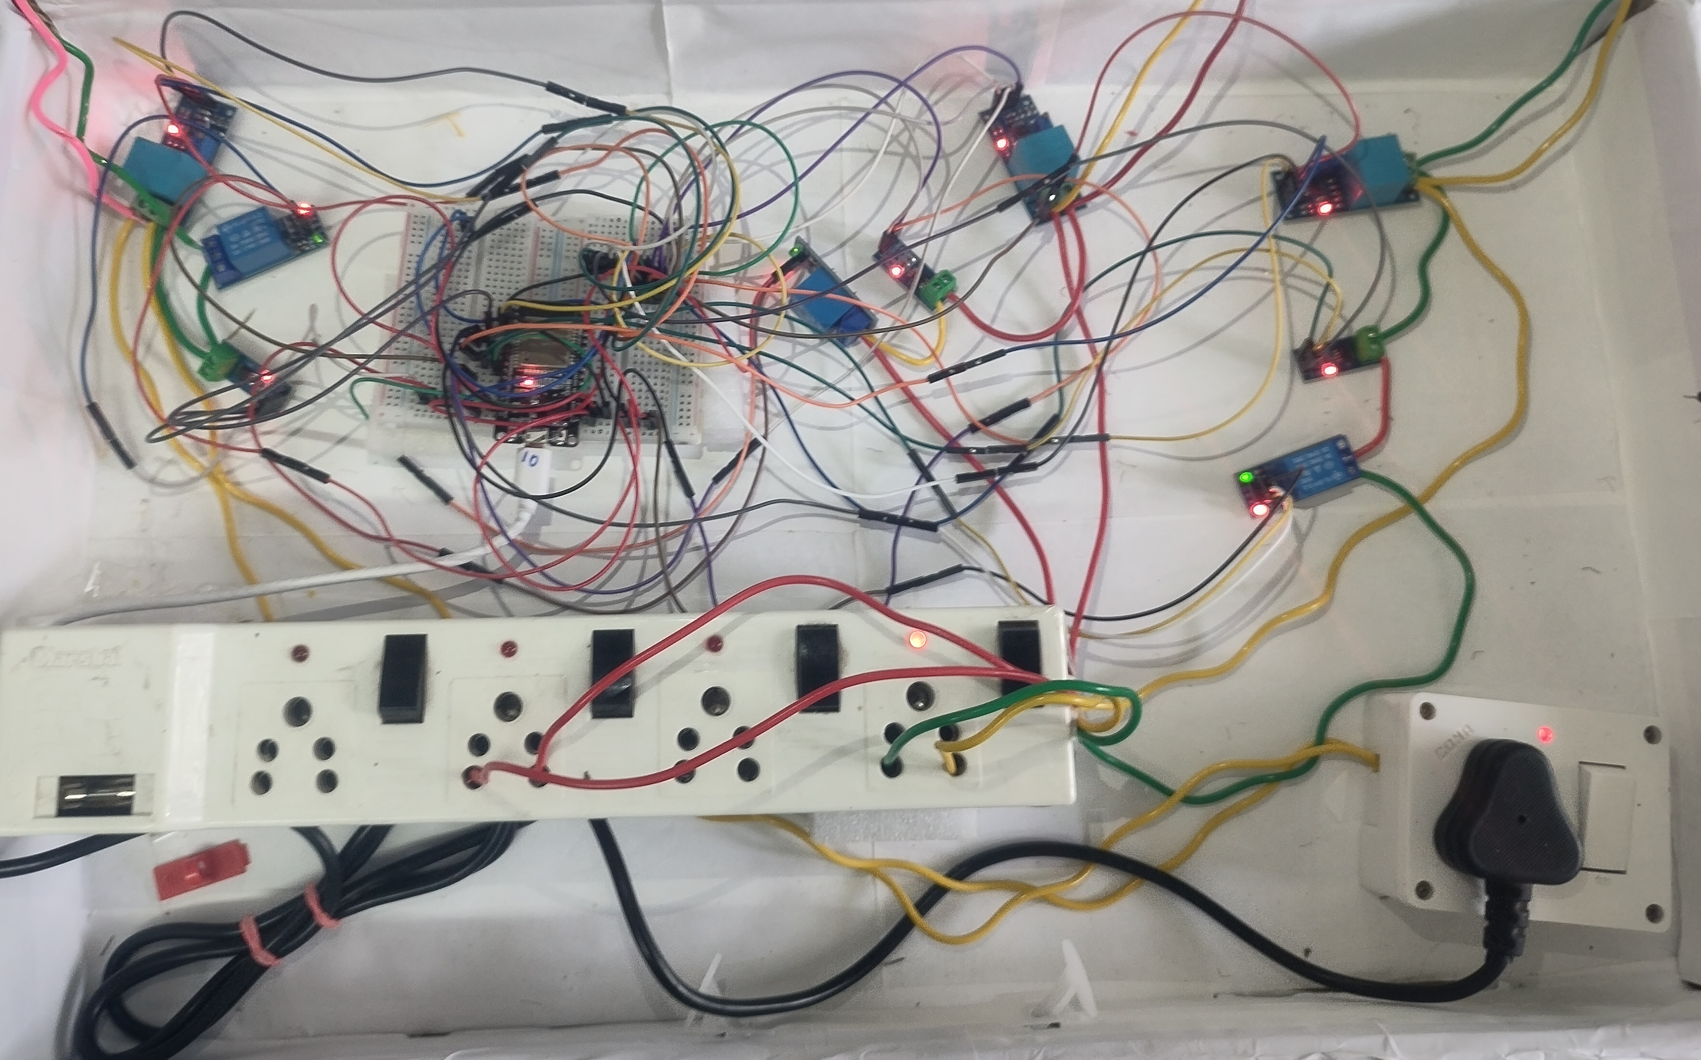
Device 1 set
Relay module
Voltage Sensor
Current Sensor
Bread Board with esp32
Jumper wire connections
Main board set
Relay module
Voltage Sensor
Current Sensor
Device 2 set
Relay module
Voltage Sensor
Current Sensor
Switch board
Main Board

Slide 12

Demo Video

Slide 13




TECH STACK
Arduino: We Intend on Using Arduino IDE and ESP32 microcontroller for controlling the sensors and the display in the smart monitor.
AWS: We intend on using AWS as our cloud backend. It will be used to store and analyse the data sent from the smart meter. It is also used to send insights to the user’s app.
Streamlit: The Streamlit is used by the customer to control his devices remotely, view historical and live data analysis and calculate his Electricity Bill.

Slide 14
Project Benefits
Energy Efficiency: Our smart energy meter project promotes energy efficiency by providing users with the tools to monitor and control their electrical devices. By leveraging real-time energy data and remote control capabilities, users can optimize their energy usage, resulting in potential energy savings and reduced electricity bills.
Convenience and Control: With the ability to control devices remotely and turn off each device individually, our smart energy meter offers unparalleled convenience and control. Users can easily manage their devices from anywhere, allowing them to create personalized schedules and routines that align with their lifestyle and energy goals.
Energy Usage Insights: Our smart energy meter project provides valuable insights into energy usage patterns. By monitoring and analyzing the energy data collected from individual devices, users can gain a deeper understanding of their energy consumption habits. This knowledge empowers them to make informed decisions regarding energy efficiency measures and identify opportunities for further optimization. Users can track their progress over time, set energy-saving goals, and receive personalized recommendations for reducing energy waste.

Slide 15
Future Enhancements
Our smart energy meter project has the potential for future enhancements, including:
Integration with Smart Home Systems: By integrating with smart home systems, our energy meter can seamlessly interact with other smart devices. This integration would enable automated energy management, such as turning off devices when no one is home(using IR sensor) or optimizing energy usage based on occupancy.
Integration with Renewable Energy Sources: Integrating our smart energy meter with renewable energy sources, such as solar panels or wind turbines, would allow users to optimize their energy usage by leveraging sustainable energy sources. This integration would further contribute to energy efficiency and environmental sustainability.
Enhanced Data Analytics: Continued development of the data analytics capabilities of our smart energy meter system would enable advanced insights and predictive energy management algorithms to predict future power consumptions. These enhancements would provide users with even more precise energy optimization recommendations and strategies.

Slide 16
Budget for Case study prototype building:
Budget for Hardware components and sensors:
ESP32 Microcontroller: INR 500
ACS712 Current Sensor: INR 200
ZMPT101B Voltage Sensor: INR 120
Relay Module: INR 150
Breadboard: INR 50
Resistors and Connecting Wires: INR 50
Cloud Services: We can use free hosting services like Render or Heroku. Or Else we can make use of the $100 free credits provided by AWS.

Slide 17
THANK YOU!!!
TEAM MEMBERS
Praveen Kumar M | CB.EN.U4CSE20449
Pradeep Karthik M | CB.EN.U4CSE20447
Maheshvar J P | CB.EN.U4CSE20436
Guruprasad K S | CB.EN.U4CSE20421

